Slide 1
System Recommendation Movie Application
Presenter:
Muhammad Yasin Aiman Bin Rohalim

Slide 2
TABLE OF CONTENTS
01
02
03
Introduction
Purpose
Intended Audience

Slide 3
TABLE OF CONTENTS
04
05
06
System Features
High and Low Level Design
Non-Functional Requirement

Slide 4
Introduction
A recommender system is a technology that utilizes machine learning algorithms to predict the likelihood of a user's interest in a particular item. It provides personalized recommendations to users based on their past behaviors and preferences. These systems are commonly used in e-commerce, online streaming services, and social media platforms.

Slide 5
Purpose
The purpose of a recommender system is to improve the user experience by providing personalized recommendations to users. This can help increase customer engagement, satisfaction, and conversion rates. Additionally, recommender systems can also help businesses make better use of their inventory, by promoting items that are more likely to sell, and reducing the risk of overstocking.

Slide 6
Intended Audience
Recommender systems aim to provide users with a personalized experience by considering their unique preferences and behaviors. The intended audience for these systems will vary based on the context in which they are being used. For example, in a commercial setting, such as an e-commerce website, the target audience is typically customers looking for product recommendations. In a content-based environment, like a news website, the intended audience is readers seeking personalized news suggestions. Additionally, there is a more general audience, such as movie-goers, who can benefit from movie recommendations.

Slide 7
System Features
Login And Register
Movie Details
Movie List
System Recommendation
User and Admin Management
Movie Trailer

Slide 8
Non-Functional Requirement
Performance
The recommendation system should provide movie suggestions within 2 seconds of user input.
The recommendation system should have a 99% uptime.
Safety
The recommendation system should implement data protection measures to ensure the privacy of user data.

Slide 9
Non-Functional Requirement
Security
The recommendation system should implement a secure login process with password encryption.
Software Quality
The recommendation system should have a user-friendly interface for ease of use.
The recommendation system should be maintainable, with clear and concise code for future updates and bug fixes.

Slide 10
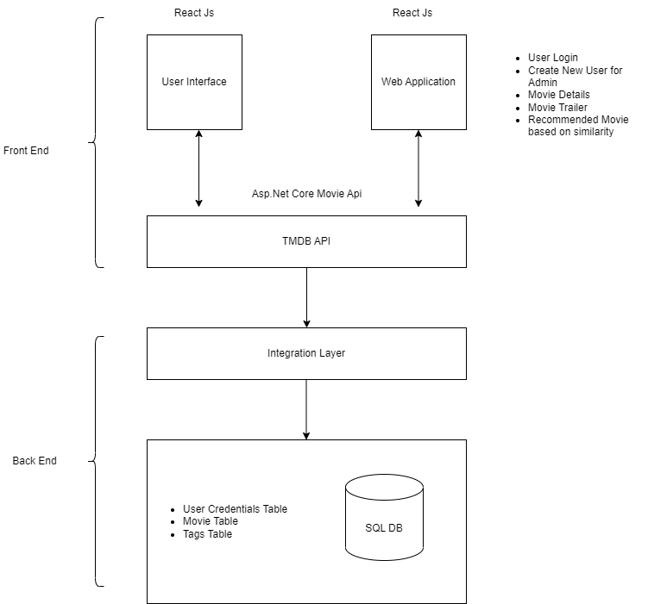
High Level Design

Slide 11
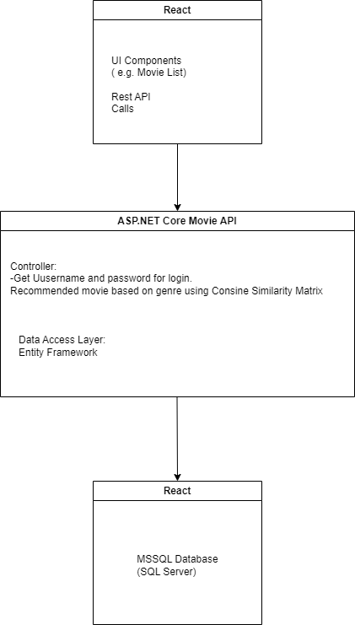
Low Level Design

Slide 12
Thank you

